Slide 1

Vet Center Survey
Reflecting on the MVP and District 5 roll outs
Michelle Middaugh, Senior Product Manager
October 2021

Slide 2
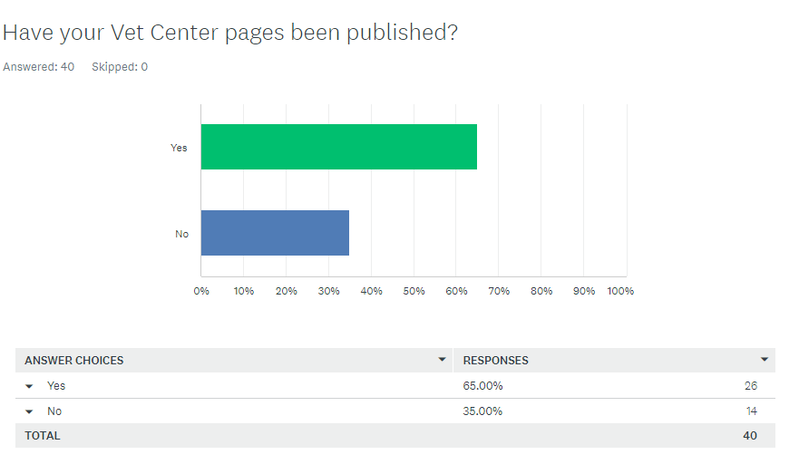
Question 1: Have your pages been published?
Vet Center Survey, October 2021

Slide 3
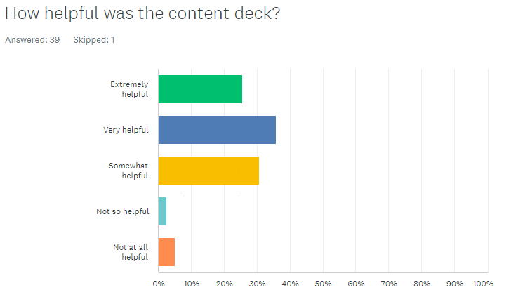
Question 2: How helpful was the content deck?
Vet Center Survey, October 2021
90% of respondents said the content deck was at least somewhat helpful.
26% (10) rated it extremely helpful.
36% (14) rated it very helpful.
8% rated it not so helpful (1) or not at all helpful (2).
Comment:
I don’t know what a content deck is.

Slide 4
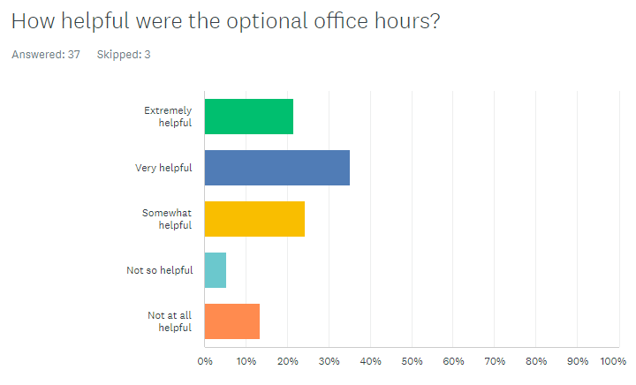
Question 3: How helpful were the optional office hours?
Vet Center Survey, October 2021
81% of respondents said office hours were at least somewhat helpful.
22% (8) rated them extremely helpful.
35% (13) rated them very helpful.
19% rated them not so helpful (2) or not at all helpful (5).
Comments:
“I attended one and it got me on the right path.”
4 respondents mentioned scheduling conflicts or lack of awareness about them. “Only having the one day conference call and having to rely on email for communication was not very favorable.”

Slide 5
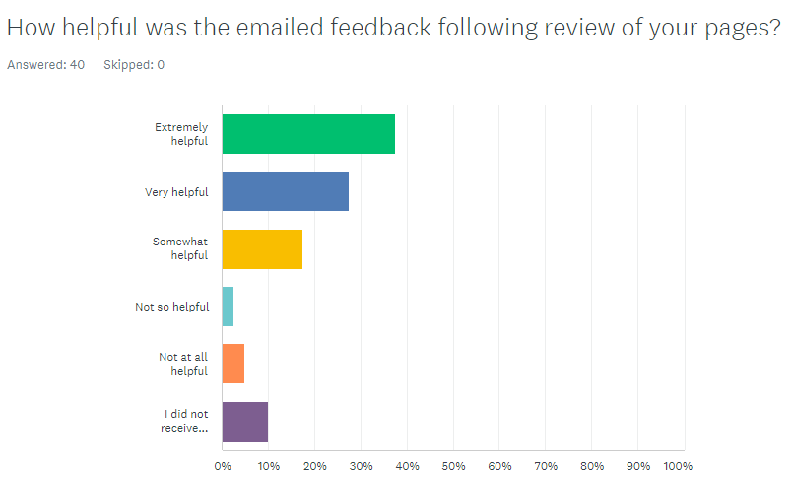
Question 4: How helpful was the emailed feedback?
Vet Center Survey, October 2021
82% of respondents said emailed feedback was at least somewhat helpful.
38% (15) rated them extremely helpful.
28% (11) rated them very helpful.
8% rated them not so helpful (1) or not at all helpful (2).
4 did not receive feedback.
Comments:
“Feedback was slow to come, company used for site setup was not available during PT.” (Respondent also indicated s(he) did not receive feedback.)

Slide 6
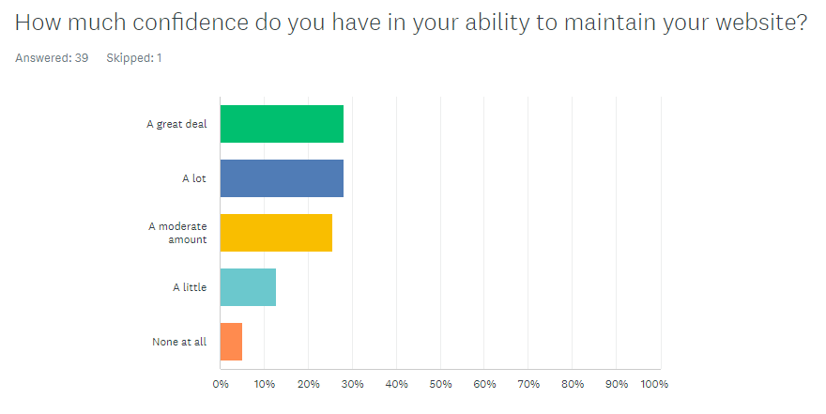
Question 5: Confidence
Vet Center Survey, October 2021
82% of respondents said they are at least moderately confident in their ability to maintain the website.
28% (11) have a great deal of confidence.
28% have a lot of confidence.
5% have no confidence at all.

Slide 7
Question 6: What would have made this learning process easier? (Part 1)
Vet Center Survey, October 2021
Vision
what learning process??? this crap was dropped on our doorsteps and we were told to just do it. what were were supposed to be "learning" here?
not doing it at all, not in the realm of our responsibilities
vision planning, brainstorming w/specific VC branding in mind w/highers, more flexibility
Satisfied
It was a easy process to learn, very user friendly.
It was pretty easy, don't know what else you could do.
Nothing it was great!!
I didn't feel like there was anything additional needed, everything went very smooth and was extremely user friendly.
nothing, great videos and detailed feedback
More tabs to produce more content

Slide 8
Question 6: What would have made this learning process easier? (Part 2)
Vet Center Survey, October 2021
Training, instructions and support
More tech knowledge
Populate standardized verbiage
A direct number to call when you had a question and not rely on an email response!
More background in web design
a physical class step by step on adding information to the pages
clarity on how some items are to be presented.
Having an in person seminar prior to building the website.
Clearer instructions.
Clearer on what was needed or if specific information needed to be in the design of the webpage. Overall it was a good process.
More classes on how to use and change website
Published examples... there seemed to be a desired template for standardization that had to be email danced back and forth. So much wasted man hours.
a video on how to do each step, but honestly I appreciated how easy it was to communicate with you regarding help
I just started working on my site. I wish there was a guide to help me get started. Maybe there is a guide and I just don't know where it is?
Support being made more available.

Slide 9
Question 7: What did you struggle with most? (Part 1)
Technical
interface, not sure what I'm editing
formatting
everything, the auditor was helpful but could have made the small changes themself
getting used to the program at first.
saving completed work
formatting pictures
originally navigating the direction
learning how to make changes
external point of contacts, I know there was a list on how to but a video would have been nice
getting my bearing with how the platform works
things saving
the picture and the special groups
Vet Center Survey, October 2021

Slide 10
Question 7: What did you struggle with most? (Part 2)
Content
listing supplemental webpage info such as; community access points and mvc info
verbage
the limited number of text character for certain sections
word limits; hyperlinks
structure
the change in requirements along the way.
nothing appeared streamlined, static, one size fits all. does not tailor towards unique branding
getting the content and verbiage of what the webpage wanted
adding the correct information to the services section.
description of services since we are in restricted status because of the pandemic.
keeping information concise and to the point. the team we worked with was phenomenal in helping me to understand best practices for website content.
dealing with the "verbiage" .... it was understood the local use boxes were to be just that, local use for local info. that did not happen... it was all contract company directed. they should have just done it themselves instead of wasting time doing the email dance
apparently, trying to adhere to the standards of personnel finalizing the webpages.
not able to produce enough content
Vet Center Survey, October 2021

Slide 11
Question 7: What did you struggle with most? (Part 3)
Time and timing
I didn't go to school for marketing, it, or public affairs. I "struggled" with having a full-time job, providing care to actual veteran clients. this additional project with an arbitrary deadline gets thrown at us in the midst of a major world meltdown. come on, man
having time to do it! not the deadline just finding the time with all the other stuff we got to do!
this was a time consuming process which makes daily tasks much more difficult.
Vet Center Survey, October 2021

Slide 12
Question 8: Which of these were barriers to your success, if any? (Part 1)
Vet Center Survey, October 2021
31 of 40 respondents replied
Understanding tasks 42%
Approval process 35%
Time commitment 32%
Technical expertise 32%
Staffing 23%
Input from directors and counselors 16%
Alignment with leadership 10%

Slide 13
Question 8: Which of these were barriers to your success, if any? (Part 2)
Vet Center Survey, October 2021
If all this is going to be top-level mandated and have to go through a fine tooth comb of scrutiny, then why don't you just make it all content from the top anyway. Why did we have to spend HOURS on this ridiculous thing to just get told how to do it anyway.
Once my web page was completed, the approval process was long.
not much barriers
Was not always sure I knew what was being asked.
:(
Guinea pigs, was like we were setting standards along the way and not having the standards mapped out beforehand, having to make changes because it was not thought through what was expected.
There was no way to truly individualize our vet center page. Every attempt to show something unique was held back by the statement it did not "adhere to the standards or regulations."
No barriers for me, don't know about others.

Slide 14
Question 9: What else would you like to share about this experience? (Part 1)
Vet Center Survey, October 2021
Frustration
When a change was required, the contracted company made the change and informed you they made the change. If a change was required should be conveyed to us to make the change so we as the website champion learn what is required by doing and not just letting someone else make the change.
Not cool. You took a potentially helpful tool and turned it into the most asinine chore imaginable
I'm not computer savvy and the content to add was highly critiqued and remote places like ours doesn’t have much information to input
If you say it is going to be local control, then let it be so. The way it was directed to publish info in the local control boxes pushes too much info.... clients don't want to have to sift through a bunch of links... they want to find out how to talk to a real person.
Job roles
This should be an admin job, not an Outreach Coordinator
Creating a webpage for a vet center should not be included as part of a Position Description for any VA employee. This should be handled by personnel who work in an individual IT department.
Confusion
Operating hours controlled by different office

Slide 15
Question 9: What else would you like to share about this experience? (Part 2)
Vet Center Survey, October 2021
Gratitude
The support staff made a huge, positive contribution to the success of this project.
IT was great training with great and helpful people
Thanks for the support.
I appreciate the opportunity to be apart of this project and am grateful for everyone's willingness to help, friendliness, and expertise.
I thought Suzanne did a wonderful job responding with suggestions. The process was fairly easy
it was easier than I thought it would be
Optimism
I think the web page for the Vet Center is a very resourceful tool, and can provide information about the services that Vet Center offers.
I am very excited that Vet Centers have these great new web pages.
I think it is going to be an awesome tool for our Veterans and for us!
The experience take me out of my comfort zone and allowed me to grow and learn from this experience.
Ideas
I would like to expand "Vet Center Highlights", allow us to post Group Flyers or Vet Center infographic
There should be a location for a digital contact card that a person can fill out online if they wish to receive more info, services or referrals

